Slide 1
Case Study 2
Attrition Example For Frito Lay

Slide 2
Attrition At Frito Lay
Created a data model to predict Attrition
Factors are
Distance To Travel
Salary
Stock Options

Slide 3
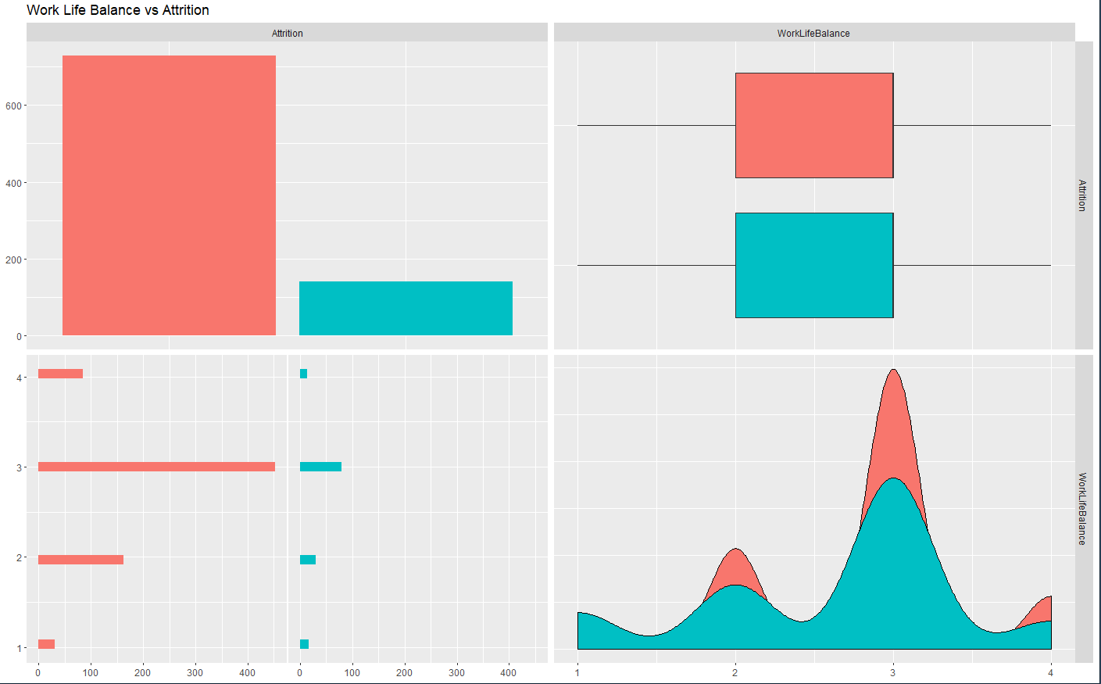

Slide 4
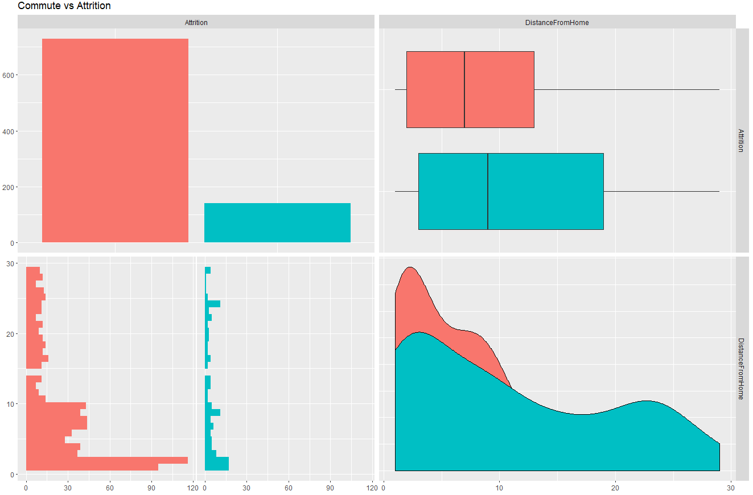

Slide 5
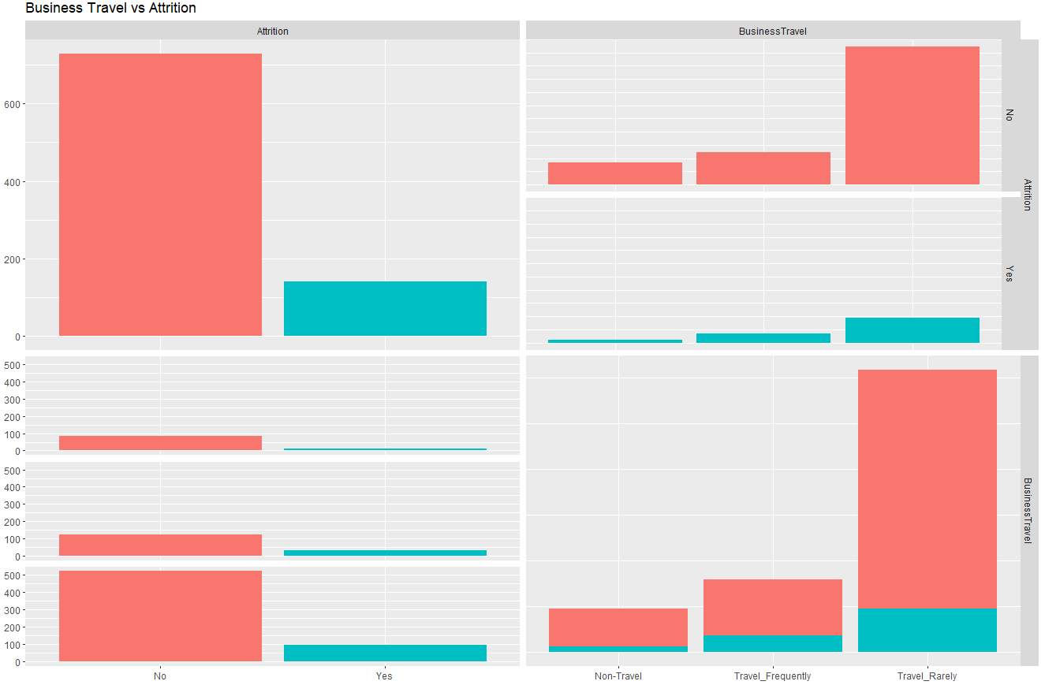

Slide 6
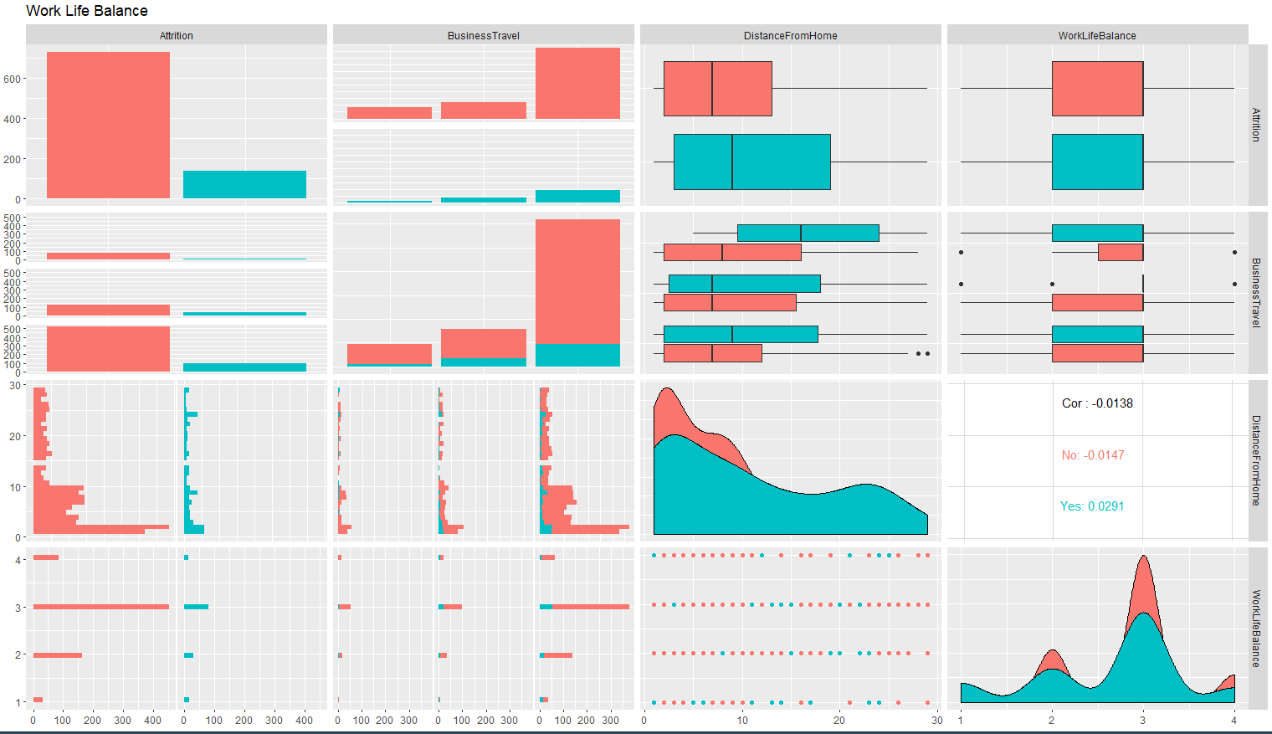

Slide 7
Retention At Frito Lay
Employee Retention
Factors to retain employees are
Training
Work Life Balance
Retain Key Employees

Slide 8
Conclusion
Employee Promotions That Drive Culture
Do your best to ensure job security
Offer multiple training options
Focus on tenured and key employee retention

Slide 9
YouTube Presentation
https://www.youtube.com/watch?v=37ujFvj8WAw&t=2s

